Slide 1




The Importance of Heart Health
A healthy heart is the foundation for overall well-being. By understanding the factors that influence heart health, we can take proactive steps to prevent and manage heart-related conditions, leading to a longer, more vibrant life.

Slide 2


Error uploading image.
Factors Affecting Heart Health
Diet
Exercise
Stress
A balanced, nutrient-rich diet low in saturated and trans fats can promote heart health.
Regular physical activity helps maintain a healthy weight and improve cardiovascular function.
Chronic stress can increase inflammation and negatively impact heart health.

Slide 3
Dataset Attributes and Descriptions
Age
The patient's age in years
Sex
The patient's gender (male or female)
Chest Pain Type(cp)
The type of chest pain experienced by the patient (4 values)
Resting Blood Pressure(trestbps)
The patient's resting blood pressure level
Serum Cholesterol in mg/dl(chol)
The patient's serum cholesterol level in milligrams per deciliter
Fasting Blood Sugar (fbs)
Whether the patient's fasting blood sugar is greater than 120 mg/dl
Resting elecrocardiogram(restecg)
The results of the patient's resting electrocardiogram (values 0, 1, 2)
Maximum heart rate achieved(Thalach)
The maximum heart rate the patient achieved during the test
Exercise induced Angina(Exang
Whether the patient experienced angina (chest pain) induced by exercise
Old Peak
The amount of ST segment depression induced by exercise relative to rest
Slope
The slope of the peak exercise ST segment
Number of major vessels(ca)
The number of major vessels (0-3) colored by flourosopy
Thal
The Thal parameter indicating the type of heart defect (0 = normal, 1 = fixed defect, 2 = reversable defect)

Slide 4
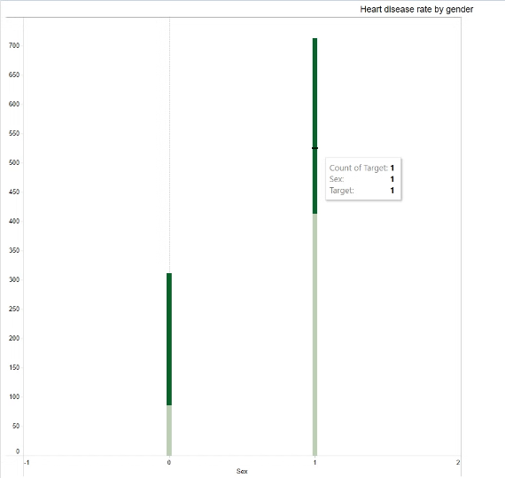
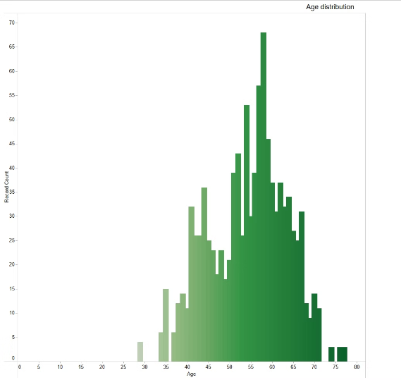
Heart disease rate by gender
Age distribution
This chart shows that males are more likely affected by heart disease than women.
This chart gives an analysis that people of age between 55-65 have more heart diseases.

Slide 5
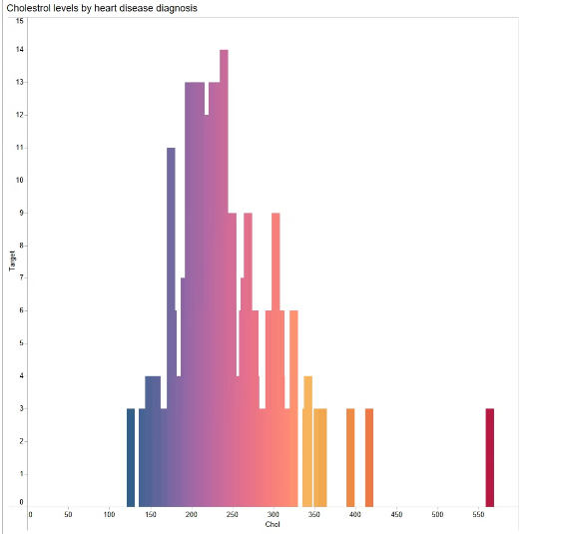
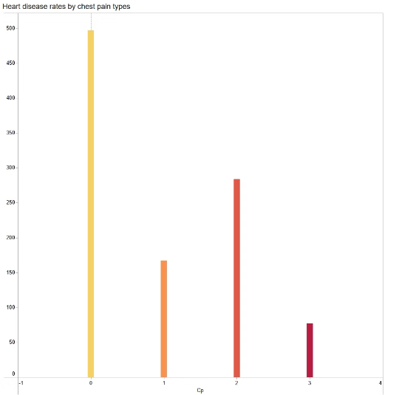
Cholestrol by heart disease diagnosis
Heart disease rates by chest pain types
It shows that people having high cholestrol between 200-250 have more heart diseases.
People having chest pain type 0 has more heart disease rate.

Slide 6
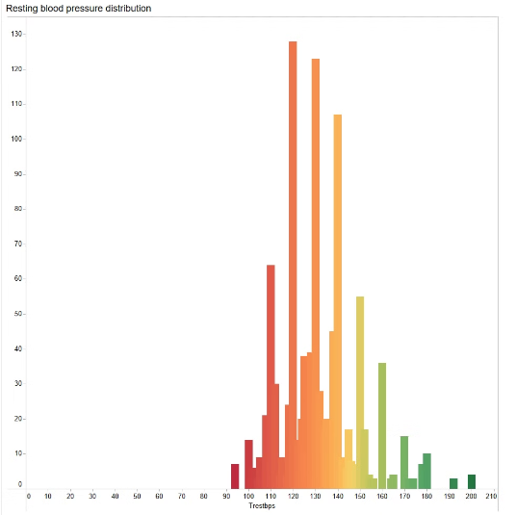
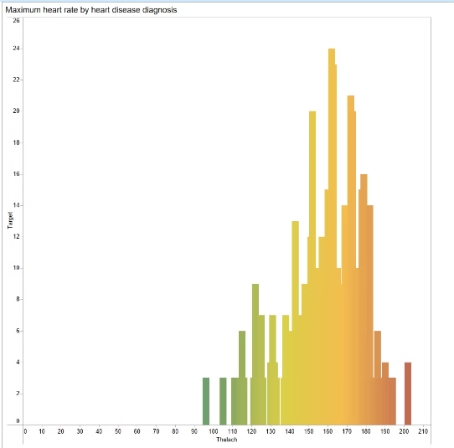
Resting blood pressure distribution
Maximum heart rate by heart disease
People having high blood pressure are more likely to be afftected by heart stroke.
This chart shows that person having more heart rate are more prone to heart disease.

Slide 7
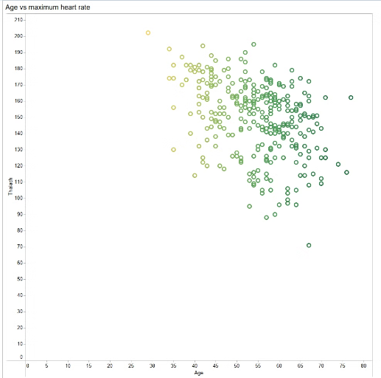
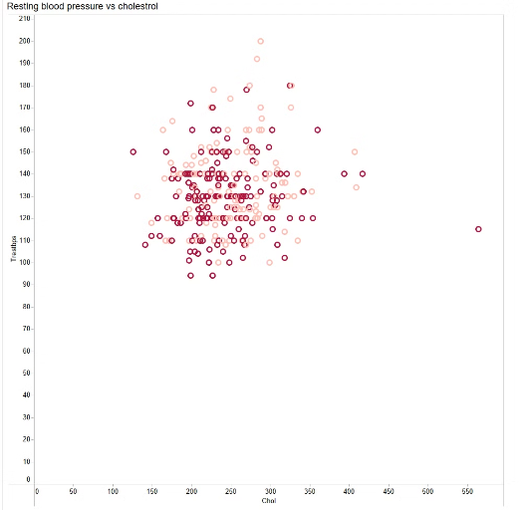
Age v/s maximum heart rate
Resting blood pressure v/s cholestrol
With reference to this data, as age of a person increase there is a steady increase in heart rate.
According to this chart people having cholestrol between 200-300 are having more resting blood pressure.

Slide 8
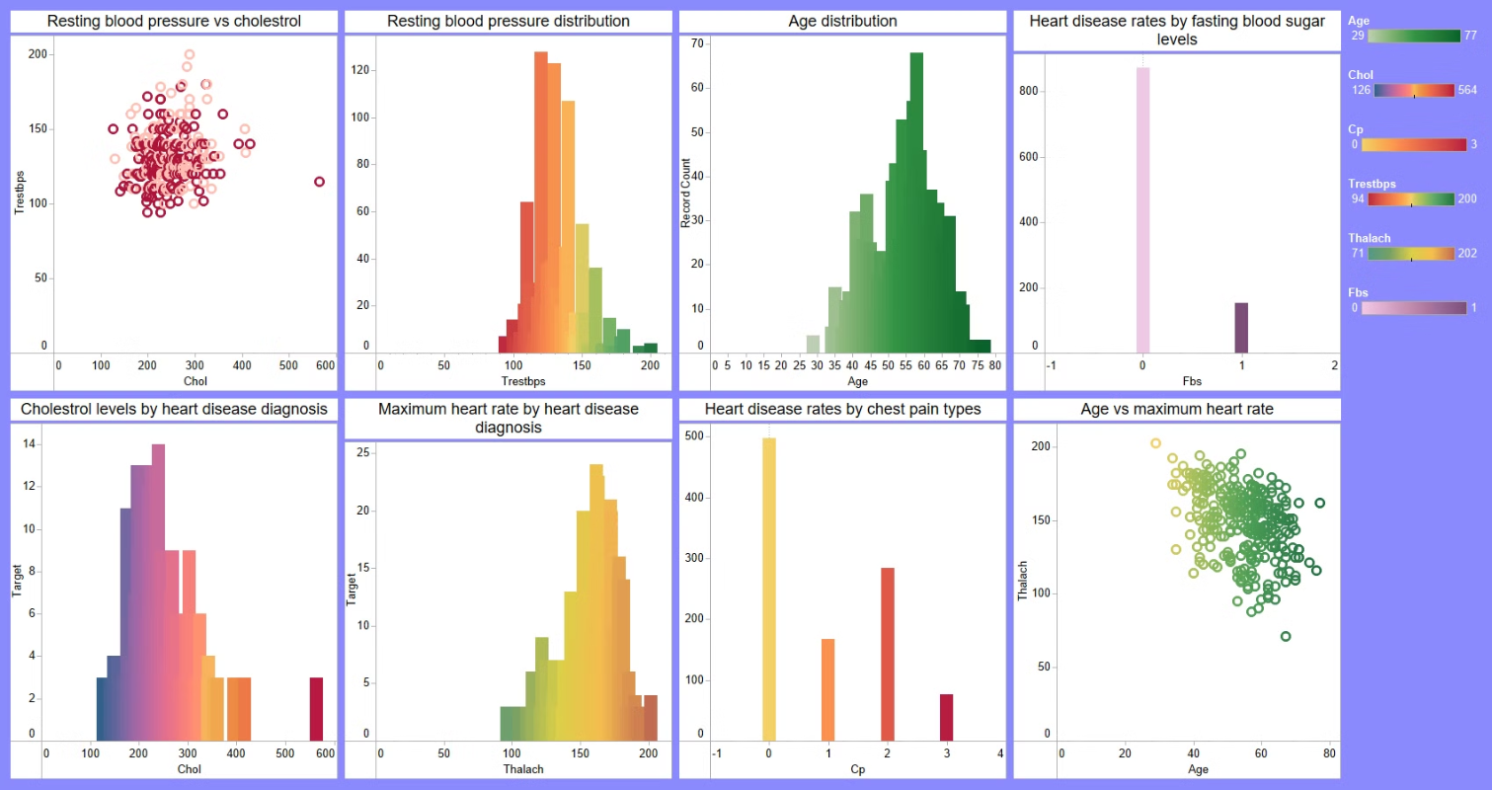

Slide 9

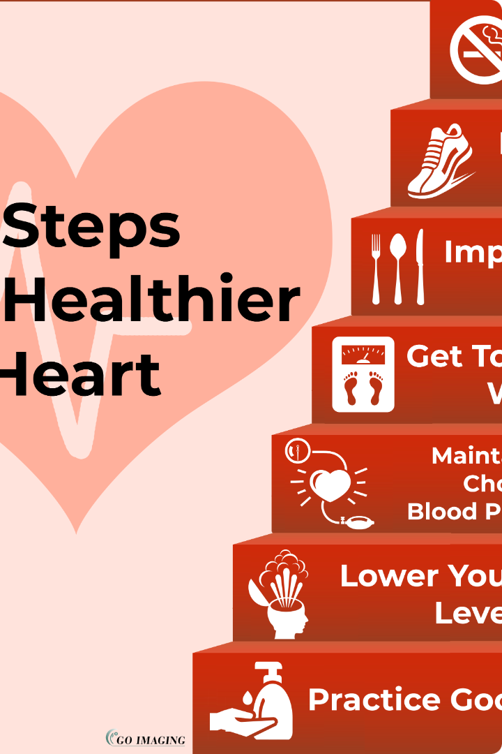

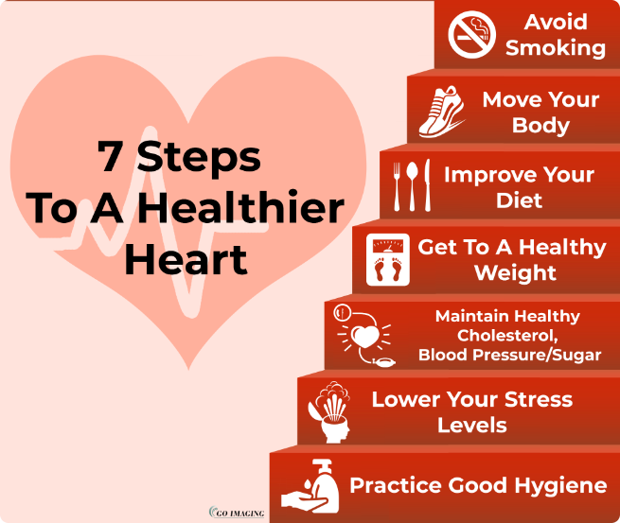


Conclusion and Next Steps
Understand Risks
Identify personal risk factors and their potential impact on heart health.
Adopt Healthy Habits
Implement a balanced diet, regular exercise, and effective stress management strategies.
Continuous Monitoring
Regularly monitor heart health metrics and consult with healthcare professionals.
By taking a proactive approach to heart health, individuals can empower themselves to live longer, healthier lives.

